Slide 1

Welcome
Class of 2027
Central Bucks High School South
Curriculum Information Night
Notes:
Counselor or Jason
Welcome to the Class of 2025!
Tonight we will share general information with you about CB South, high school scheduling, and the course selection process. It is our hope that this presentation will help our families better understand the program planning timeline, high school schedule, and credit requirements for graduation.
Please note that on the Curriculum Information link on the South Student Services Webpage, there are links to the following important resources that you can refer back to throughout this process:
*The 2023-24 Program of Studies
*The Course Selection Sheet (which lists all courses and course codes necessary for input into Student Portal Course Registration)
*Instructions for Course Selection in Student Portal
*The Program Planning Timeline
*The Block Scheduling Worksheet to help students visualize what might fit into their high school schedule
*A list of Department Coordinators at the high school with contact information should you have specific course-related questions.
We hope you will find this information helpful as you make decisions about your high school curriculum.

Slide 2

Administration and Student Services Staff
Principal
Mr. Jason Bucher
2024-2025 Grade Level Principals
Mrs. Jennifer Opdyke (10)
Mr. Brian Scholl (11)
Mr. Joseph Piselli (12)
School Counselors
Mr. Kerry Monk
Mr. Tom Hill
Mrs. Jessica Kirwan-Shaw
Mrs. Taryn Barrett
Mrs. Michele McGroggan
Mr. Patrick Chapman
Mrs. Laura Ladley
Mrs. Rachel Davis, Student Support Counselor
Mrs. Jennifer Caramenico, Emotional Support Counselor
Notes:
Principal

Slide 3
Support
Through the Years
School Counselor
Administrators (Grade-level & Building Principal)
Class Advisor
Titan Forum Mentors
  Titan Forum- students stay with their Titan Forum peers & mentor for all 3 years
Writing Center- resource regularly used by ALL students!
Peer Tutors- work with hand-selected students
Notes:
Principal

Slide 4
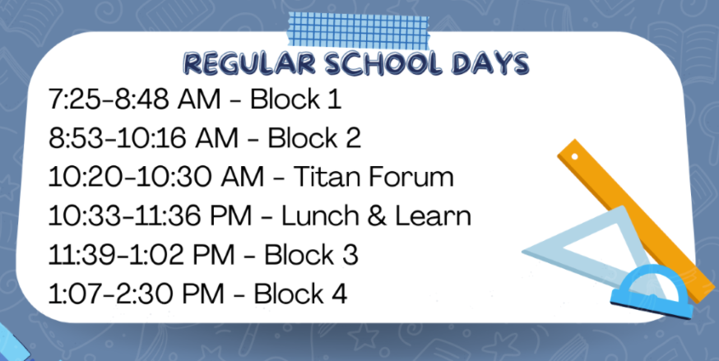

The Typical Day Schedule
Notes:
Principal

Slide 5

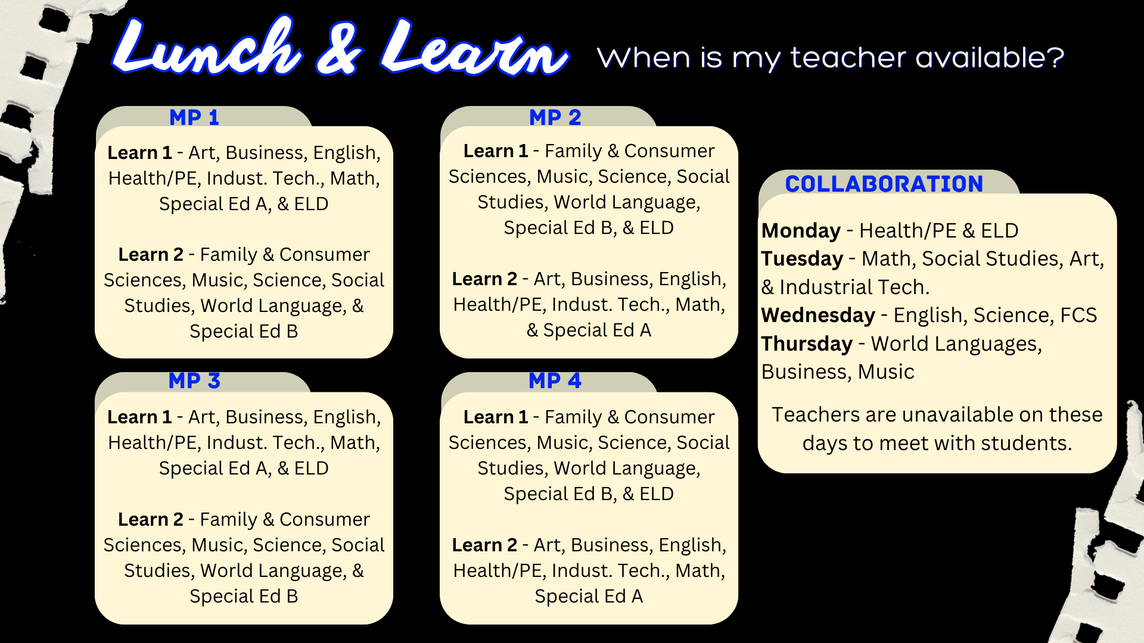
Lunch & Learn
63 minutes daily
Time Management
Based on individual needs – Academic, Physical Wellness, & Social-Emotional Wellness
Notes:
Principal

Slide 6
Program Planning Timeline
Program of Studies posted on District Website January 2nd
Curriculum Fair 6:30 PM January 4th @ South
Portal OPEN for registration January 18th – February 4th; Students enter course requests based on recommendations from teachers
Counselors review course selections through March
Verifications available on portal 3/8 for parent review and e-signature; submit change notifications to Grade 9 counselor
Staffing and Master Schedule process April - August.
Counselors do schedules in the summer; you will be contacted if a conflict cannot be resolved utilizing pre-selected alternates.
Schedules posted on Portal late August
Notes:
Counselor- remaining slides
Now that we’ve shared some general information about South, we will focus on course selection.
After receiving recommendation feedback from middle school teachers, students can go onto student portal to begin entering course requests.
We ask that students carefully consider what their future goals are, what personal interests they might like to explore, how much they wish to challenge themselves, and what the appropriate “next step” is for them in sequential courses.
While it is important to challenge yourself, we also place great emphasis on mental wellness and encourage students to select courses of appropriate rigor and balance. For this reason, we strongly encourage students to have conversations with their current teachers and middle school counselor for advice on which courses might be most appropriate.
Once the window for course requests is closed, counselors will review all course requests.
While we do our best to fit in all course requests, schedule conflicts may occur. Therefore, we ask that students add 2-4 alternate courses in the event there is a scheduling conflict.

Slide 7
Scheduling Requirements
All sophomores must schedule the following:
*English 10- 1 credit
Social Studies- 1 credit
Math- 1 credit
*Biology- 1 credit
PE/Health should be entered unless attending MBIT
* DENOTES KEYSTONE TRIGGER COURSE
Notes:
Counselor
All sophomores must schedule the following classes for the sophomore year-
1 credit of English
1 credit of Social Studies
1 credit of Math
1 credit of Biology
Sophomores should also request PE 10 which equates to .5 credits. As mentioned in a previous slide, students who attend MBIT from sophomore through senior year are exempt from the .5 PE requirement at South.

Slide 8
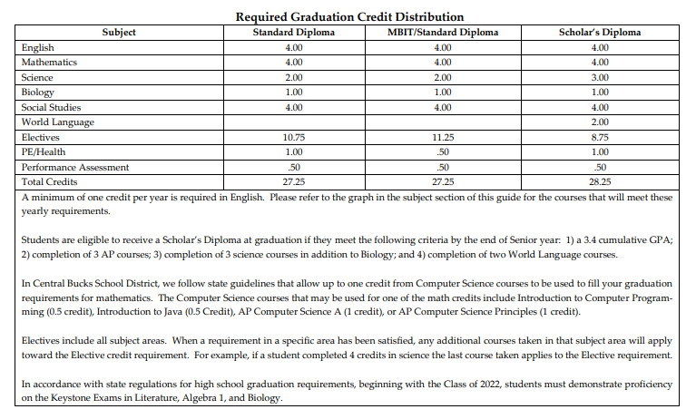




Notes:
Counselor
Central Bucks School District recognizes 3 Diplomas:
The first is the Standard Diploma.
The second is the MBIT Standard Diploma for students who attend MBIT for 3 years.
And the third diploma is the Scholar’s Diploma.
The only difference in the MBIT Diploma and Standard Diploma is that students who attend MBIT for three years are exempt from PE 10- so they need .5 credits vs 1 credit of PE and instead earn an additional ½ credit towards electives.
Students are eligible to receive a Scholar’s Diploma at graduation if they meet the following criteria by the end of Senior year: 1) a 3.4 cumulative GPA; 2) completion of 3 AP courses; 3) completion of 3 science COURSES in addition to Biology; and 4) completion of two World Language courses.

Slide 9
Block Scheduling
Four 83 minute classes per day;
8 credits maximum per year
Notes:
Scheduling at the high school is much different than in the middle school. Students have only four classes a day, each class runs 83 minutes in length. Because classes essentially run for double the amount of time each day, what would normally be a year long course is now just half a year, or one semester long.
Each Marking Period equates to a half credit per block.
Many elective courses are .5 credit, meaning they run every day for one Marking Period.
Classes that are 1.0 credit run every day for two marking periods (or one full semester).
A few classes, such as AP European History, are worth 1.5 credits and run three Marking Periods.
If a course, such as a PE Elective, runs every other day (on A or B days only) for one Marking Period, it is worth .25 credit.
If a student fills their schedule, they can earn 8 credits in a school year.
It is important to note that most students will earn a surplus of credits by the time the reach senior year. Some students choose to have a study hall or Team Study during a particular marking period because they know they will have a particularly rigorous or busy marking period. This is perfectly fine. Students can have study halls in their schedule and still graduate with plenty of credits, provided they don’t fail courses along the way as well.

Slide 10
Full Day Sophomore Schedule with Music
Notes:
This is an example of a student who is taking one of our music courses.
Music courses such as Chorus, Band, and Orchestra run all year long on A or B days only. They are worth 1.0 credit.
“Opposite” the selected music class, students should consider taking their Wellness Fitness class (code 7062) for one semester and one of the many offerings on the back of the Course Selection Sheet the other semester.
**Please note the options in this example are just some of the options available.

Slide 11

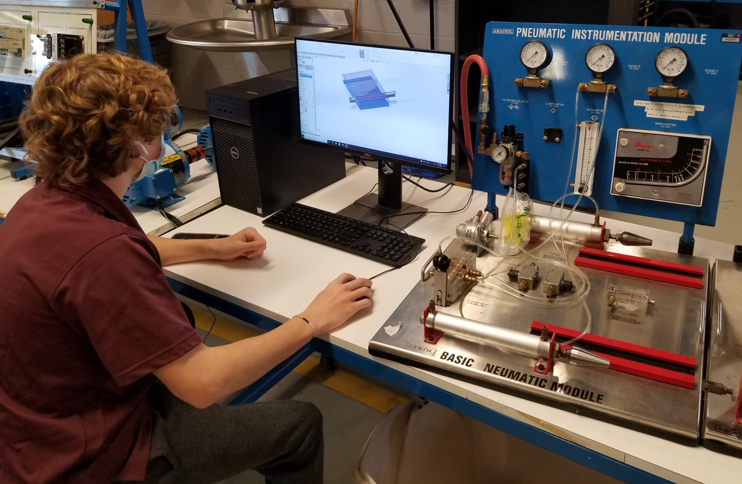
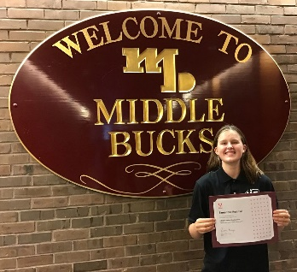
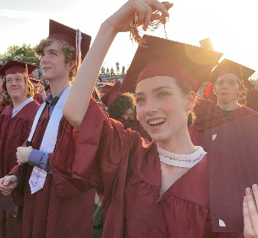
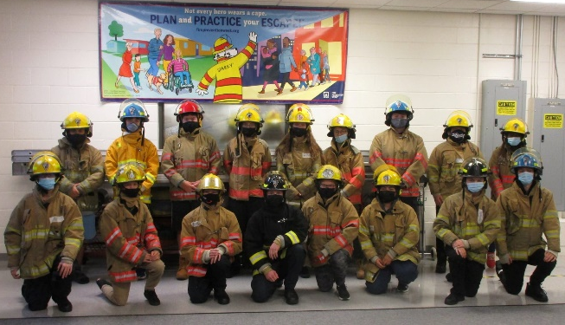
Middle Bucks Institute of Technology(MBIT)
MBIT is a Career & Technical Education(CTE) High School of choice
  Students choose to attend MBIT for half their day, in place of electives
  Attend morning(7:45am-10:15am) and afternoon(11:30am-2:15pm) sessions
MBIT offers 21 programs across five, diverse career pathways
  All programs are designed to be completed over 3 years, in three levels(100, 200, 300)
  All three levels of the programs are to be completed during the student’s 10th, 11th, and 12th grade years
MBIT prepares students for their career goals
  During their time at MBIT, students can earn Industry Certifications and College Credits toward their post-secondary plans
MBIT and the high school coordinate for students
  MBIT will share grades, attendance, and discipline records with the high school
  Transportation to MBIT is provided by the high school
  Students will eat lunch their lunch at the high school
  Students can still participate in extracurricular sports and activities at the high school
Students apply to be considered for enrollment at MBIT
  Students should be in good standing (academic, attendance, and discipline) to be considered for enrollment at MBIT
  Applying early helps students to be considered for top choice programs.
  Programs are expected to fill to capacity and qualified applicants may be waitlisted
Notes:
MBIT is a career and technical educational program that student can choose to attend in place of electives for half of their school day. Sessions are offered both in the morning and afternoon and placement is determined by chosen program availability and level of placement. There are 21 programs to choose from offering students 3 years of career and technical education leading towards various industry certifications and possibly even college credits. MBIT shares student information such as attendance, academics and behavioral concerns ensuring a collaboration between south and MBIT. Bussing is provided to and from MBIT from South and students are encouraged to participate in clubs, sports and various activities here at school

Slide 12
MBIT Schedule (AM or PM determined by MBIT)
Transportation provided between South and MBIT.
Students take CBSD bus to South in the morning & home in the afternoon.
*No PE required for MBIT Standard Diploma (see slide 9)
Notes:
This is an example of what a student’s schedule might look like if they attend MBIT half day. Students who participate in an MBIT program spend half of their day at MBIT and half at South. They always eat lunch at South, regardless of whether they attend MBIT in the morning or afternoon session. Students who are in programs at MBIT essentially are taking their elective credits at MBIT and their major academic requirements at South.

Slide 13
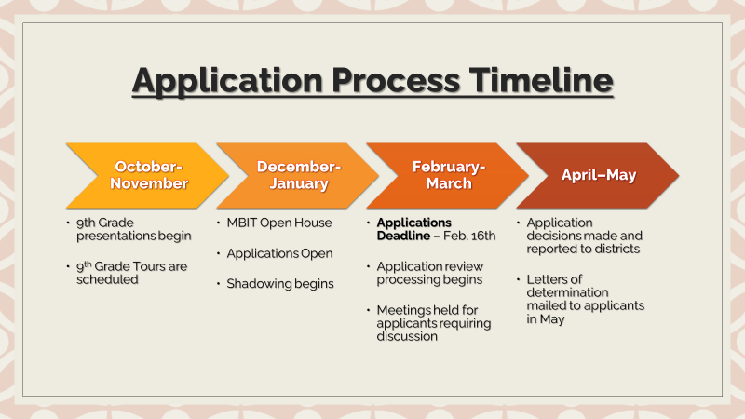
MBIT Admissions
Schedule to Shadow a Program!
MBIT Campus Tours
Email all questions: ​applications@mbit.org​
Notes:
Applications for MBIT are now open and priority deadline is approaching soon. Students should be in good standing (academic, attendance, and discipline) to be considered for enrollment at MBIT and are encouraged apply early for the best consideration in their chose programs. Programs fill up fast and are offered to students in various schools not just South or even Central Bucks. As applications are reviewed, MBIT will reach out to counselors, students and families for any additionally required information before making decisions and notifying applicants in late Spring (usually May).

Slide 14
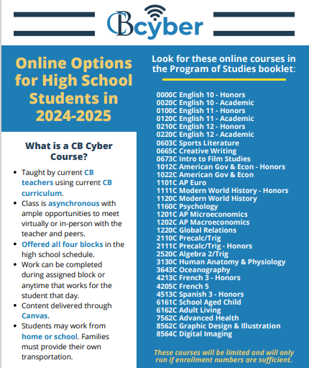

Slide 15

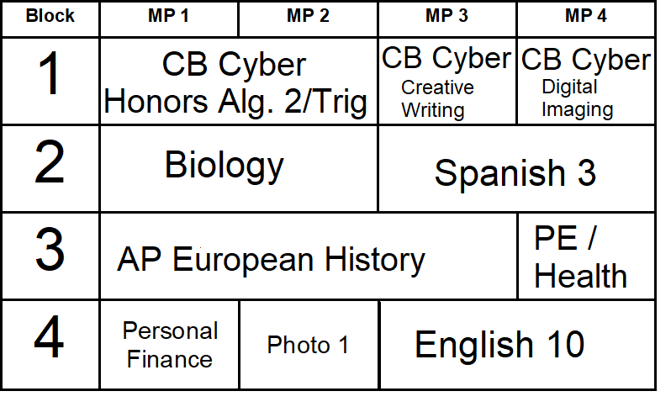
Full Day Schedule with
Notes:
This is an example of a student taking a full year of the new CB Cyber option. They will not be scheduled for courses during 1st block with the option to work virtually from a location at school or from home with their own transportation to school. They will be offered a mix of 1 credit and .5 credit options to fill their graduation requirements.
**Please note the options in this example are just some of the options available.

Slide 16

Can I Change My Schedule after program planning?
Changes after February 4th are limited to…
  pre-requisite issues
  course misplacement
  course failure
*Teacher-approved level changes by the last day of 9th grade. Teachers are not available to recommend or approve schedule changes in summer before tenth grade. New HS counselor will not be able to make those changes in summer.
Confirm with your 9th grade counselor he/she has been notified by your teacher and that the change has been made!
Notes:
Per District Guidelines outlined in the Program of Studies, requests for changes after the March deadline are limited to the following reasons:
The student hasn’t met the pre-requisite for a course (for instance, the student had a D in French 2 so he/she has not met prerequisite for French 3).
The student has been mis-placed in the course (for instance, the student is in English 11 instead of English 10 or the teacher has identified that the student has not been placed in the appropriate level).
The student failed a course and can reschedule the course for the second semester. In that case, courses may be taken out of a student’s schedule so the required course can be rescheduled.
If a student feels they have been misplaced but has met pre-requisite, there are steps the student must take for a change to be considered. We call this the Academic Concern Process which involves documenting remediation attempts, student-teacher-parent conferencing, and administrative approval.
Please note that because most electives do not have prerequisites, they often do not meet the criteria for a course withdrawal. Therefore, it is very important that students investigate courses closely before requesting them.
We often hear students say they requested courses so they can try to be in classes with their friends. While we completely understand that students hope to be in classes or lunch with friends, we caution students against making decisions based on others’ requests. With almost 600 students in the Class of 2025 and almost 1800 students in the building, there are multiple sections of each course. This makes it impossible to predict how a schedule might be built. We ask that you talk with your family and make decisions regarding courses that are right for you!
We also understand that a student might be questioning which level is most appropriate prior to their 9th grade courses coming to an end. Please consult with your teachers PRIOR to the end of the school year if a level change is being requested. Your middle school counselor will make any approved changes. Note that the high school counselors cannot make changes to levels as they are unfamiliar with your academic record.

Slide 17
9th Grade Counts!
The grades earned in 9th count just as much toward your cumulative GPA as 10, 11, or 12.
Students must make the effort now so that they won’t have to make up ground in later years.
Notes:
TB
A high school transcript includes courses, grades, credits, and attendance records from 9th through twelfth grades. Thus, the grades earned in 9th grade count just as much toward a student’s GPA as 10, 11, and 12.
We hear all the time from students that junior year is the MOST important year. This is simply not true. Each year of high school is equally important.
Our hope is that our current 9th graders recognize that although they are “housed” in the middle school, that they take their academics seriously, as their 9th grade final grades and attendance will be noted and calculated on their high school transcript.

Slide 18
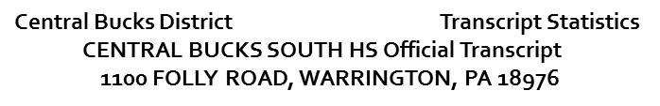
9th – 2.42
10th – 3.37
11th – 3.71
Overall Cumulative GPA – 3.2
Grade 09 UNAMI/TAMANEND MS
Course Mark Credit
ENGLISH 9 C 1.000
US HISTORY C+ 1.000
ALG 2/TRIG B- 1.000
SCIENCE 9 B 1.000
FRENCH 2 B 1.000
COOKING F 0.000
3-D DESIGN D- 0.250
FITNESS/HEALTH 9 A 0.500
Success Plan P 0.250
Grade 10 CB SOUTH HS
Course Mark Credit
ENGLISH 10 B 1.000
JOURNALISM B+ 0.500
MOD WRLD HIST B 1.000
GEOM/TRG A- 1.000
ACAD BIOLOGY B 1.000
FRENCH 3 B 1.000
INTRO to COMP PROG A 0.500
JAVA A 0.500
WELL/FIT 10 A 0.500
PHOTOGRAPHY 1 A 0.500
Grade 11 CB SOUTH HS
Course Mark Credit
English 11 A 1.000
AM GOV ECON SYS A 1.000
PSYCHOLOGY B 0.500
PRECALC/TRG3 A. 1.000
ACAD CHEMISTRY A- 1.000
FRENCH 4 B+ 1.000
ACCOUNTING B+ 1.000
HUM DEV:CHILD A 0.500
Lifetime Sports A 0.250
Notes:
Inevitably, we have seniors who – when beginning the college application process- reflect upon their freshman grades and wish they had performed better.
Here is a student whose GPA in 9th grade was a 2.44, 10th grade ended with a 3.42, and 11th grade finished with a 3.77. This student’s cumulative GPA ended as a 3.41.
A 3.41 is a solid B+ average. We talk all the time to our students about creating options for themselves. This student will certainly have college options, should they choose to pursue post-secondary education. That being said, the number of options they might have had could have been greater had their freshman year GPA been higher. To put this in the best perspective possible, the average accepted GPA for Penn State Main Campus is around a 3.6/3.7 cumulative grade point average. Had this student’s final grades their 9th and 10th grade year been similar to their junior, admission to Penn State Main Campus would have been highly likely. However, PSU for this student, although certainly not impossible by any means, may be considered more of a “reach”.
The great news about this student is that they have shown GROWTH . They have proven that they are capable of a college preparatory curriculum and can discuss that growth with an admissions counselor. If you feel your performance in 9th grade isn’t reflective of your ability, you have plenty of time to improve your grades and prove what you are capable of. We never want our students to look back at their academic records and have regrets… so do the best you can now and show what your capable of.

Slide 19

Departmental tours & activities fair
7-8 pm
Notes:
Thank you for taking the time to review this general information about Program Planning and CB South. We invite families to meet our teachers and check out the facilities on the 2nd floor. Our academic departments will be available to discuss the courses available to our rising sophomores, elective options within their department, general sequencing of courses, career connections, and frequently asked questions related to their department.
If you have specific questions regarding your student’s course requests, we ask that you contact your student’s middle school counselor or middle school teachers directly, as they know your student best and will be working with your student to finalize course requests and recommendations over the coming weeks. Middle school counselors have access to student’s academic records and teacher recommendations and can best guide your family through student-specific questions.
We also encourage you to review the information provided by our high school departments on the Curriculum Information page located on the South Guidance Webpage.

Slide 20
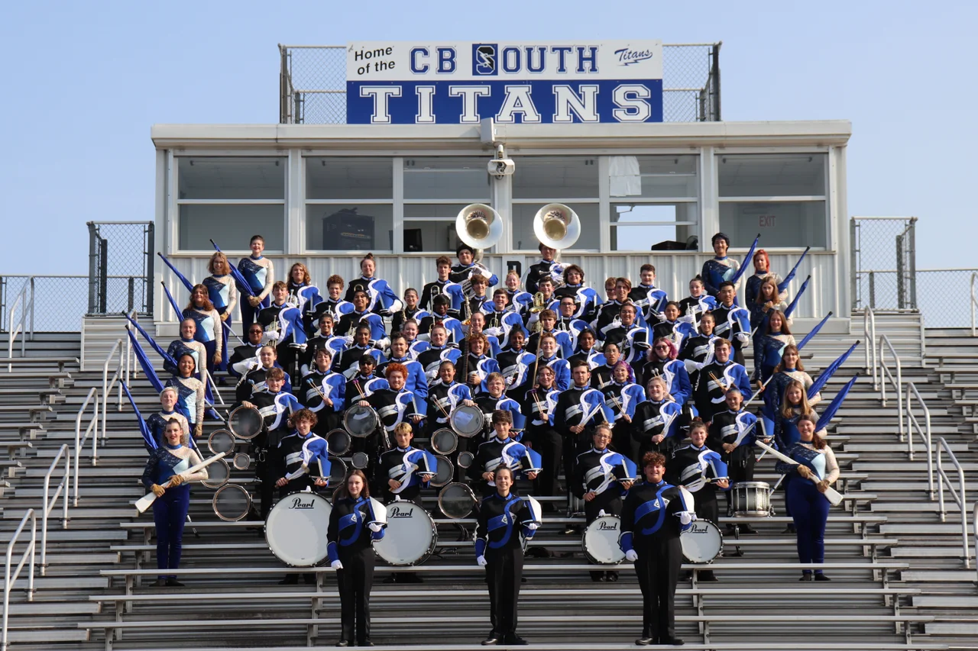
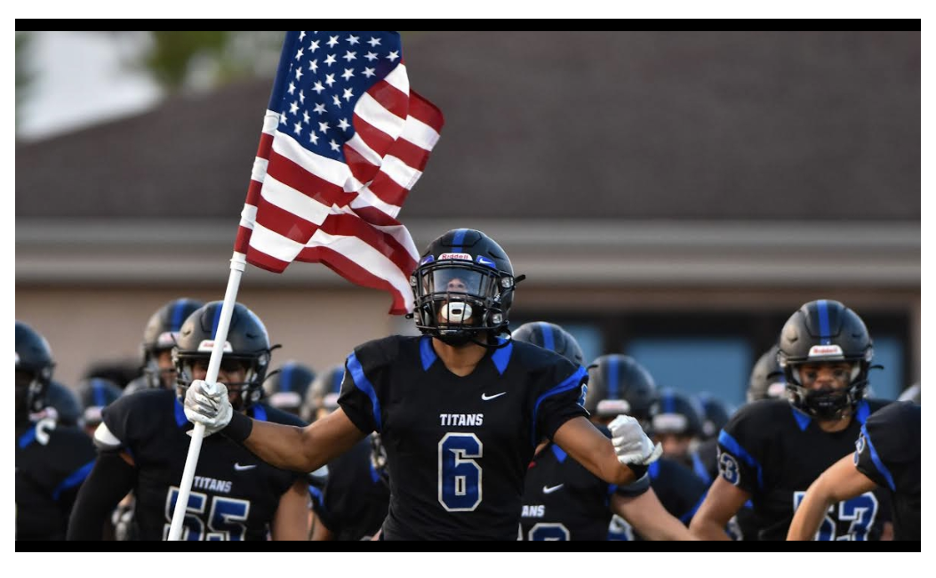
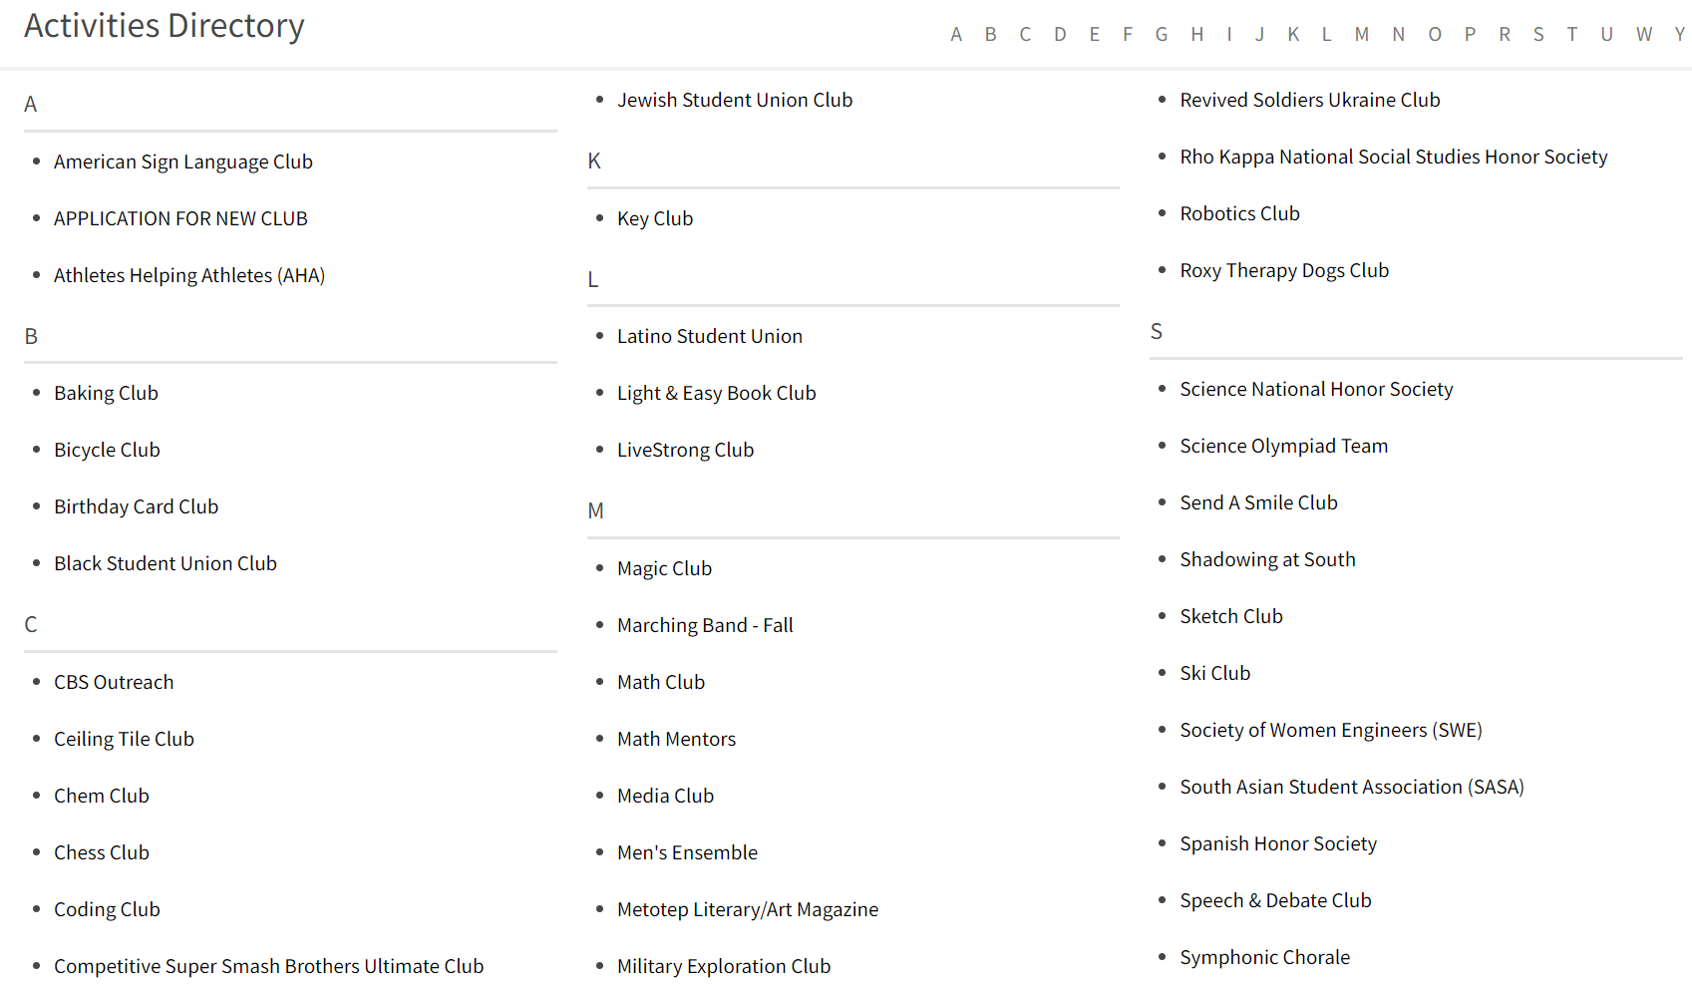
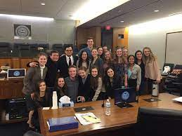
Student Life: activities fair in cafeteria!

Slide 21
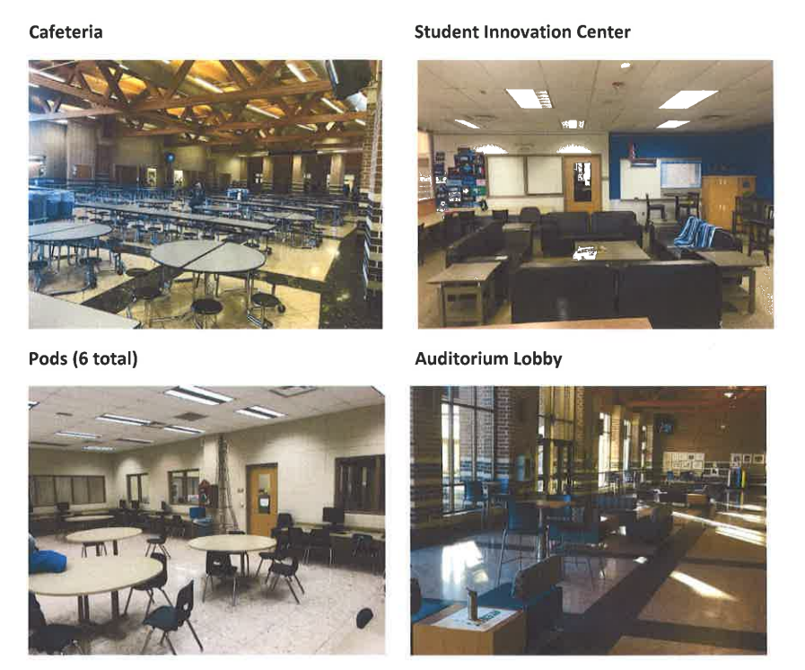
Check out the facilities!

Slide 22
Tour the 2nd floor check out facilities meet teachers see course materials
Activities Fair in Cafeteria
*Please begin in the B Wing

